Slide 1
Learning by Optimization

Slide 2
Learned Functions (Models)
Data
Input
Function
Output
x
f(x)
y
Notes:
Let’s review this diagram from the last lecture. Remember that we want to use data to learn functions that predict an output y for an input x. We call these learned functions models. Why a model? Well our functions will make simplifying assumptions about the real world, so they only model the real complex dynamics that actually relate, say height to shoe size. And what is the data? Examples of inputs and corresponding outputs from which we seek to generalize.

Slide 3
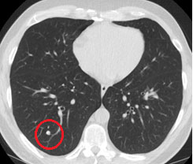
Learned Functions (Models)
Data
Input
Function
Output
x
f(x)
y
Lung Cancer CT
Notes:
Again, it’s nice to be concrete. Recall we talked about the problem of predicting cancer from CT scans. Here each input is a CT scan image. The output is whether that scanned patient has cancer. This means the data consists of scans labeled as cancerous or non-cancerous. We often refer more specifically to the data as “labeled data” or “supervised data” because crucially, the desired output is included. This allows for supervised learning.

Slide 4
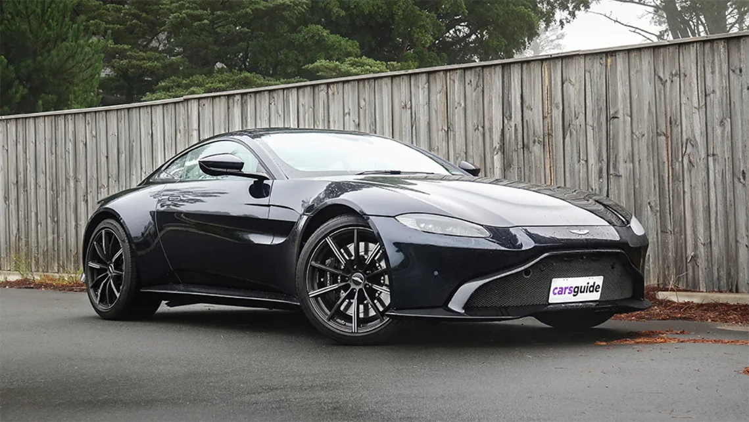
ML Framing: Car Pricing
Inputs and Outputs
Labeled data
Split train/test
Evaluation
Baseline
Use in practice
Notes:
Let’s review our framing questions with another example. Imagine you’re a ML expert hired as a consultant to price new cars. You are given a list of various recently released cars and their prices. You look up a set of standard features for each one (horsepower, number of seats, etc.) This is your labeled data: input car features and output dollars.
For evaluation, you decide to use 80% of your labeled examples for training and 20% for testing, selected at random; this is your train/test split. As your evaluation metric, you decide to use the average absolute difference (in dollars) between the predicted prices and the actual prices of the cars in your test set. To help understand performance, you need a reasonable baseline. Since you don’t know much about cars, you decide your baseline predictor will simply be the average price of the cars in your training set. By the way, why not use the average price of cars in your test set? Well, this would be a form of cheating: you don’t get to look at your test data at all in building any of your models -- even the baseline.

Slide 5
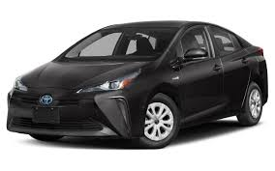

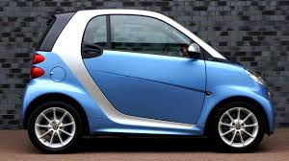
Features
Size
Engine type
Horsepower
Seats
Trunk size
etc.
Notes:
As I just suggested, each car is described by a set of features. We’re going to talk about features a lot in the this course. They are the mechanism by which we decompose whole objects into common pieces. Without common pieces, we can’t generalize about new cars we don’t know. So we choose size, engine type, horsepower, number of seats, and so on, as a way to describe a car. Of course there is more to car than our set of features, but we are making the assumption that these features are sufficient to model the relationship with price.

Slide 6
How Does Learning Work?
[Logic]
Size
small
large
HP
Luxury?
>250
yes
Notes:
So far, we’ve talked about just about everything except the learning process itself. How do we turn labeled examples into a prediction function? How does learning work?
In the 1980s, AI researchers asked themselves this question and thought, well, how would I describe the process of making an informed prediction? Often people explain their own thought processes using logic, depicted here as a decision tree. First, consider the size of the car. Is it large or small? If it’s large, next consider whether it’s a luxury vehicle, and so on, and at the bottom of this tree you’d get to dollar amounts. Early machine learning efforts tried in various ways to replicate this knowledge in “expert systems”. It mostly failed.
The problem is that humans, even those with great expertise, can have trouble articulating their decision-making process. We don’t even have conscious access to the decision-making part of our brains, and certainly not the learning part. So if we want to design a learning algorithm, it’s risky to try to replicate what we say we’ve learned.
Machine learning really took off when the field adopted a more statistical approach to learning.

Slide 7

How Does Learning Work?
[Optimization]
Loss
HP
Size
Notes:
The approach is statistical, but it also leverages what computers are particularly good at: arithmetic. Adding and multiplying. We turn the learning task into a numerical optimization task and try to solve it. In this case, we’ll choose a “loss” function that is minimized when we perfectly predict the prices of all the cars in our training data. More on that in a moment.
The point here is that modern machine learning is probably still quite dissimilar from what goes on in your brain, but the algorithms have co-evolved with computer hardware that supports it.

Slide 8
Learning by Optimization
Notes:
Q: Modern machine learning typically uses
(a) logic
(b) numerical optimization
A: (b)

Slide 9
Linear Regression
Notes:
If it wasn’t already clear, we’ll be taking the statistical approach to learning. And as you might expect, we’ll start with linear regression. It’s an old standard, invented back in the early 1800s for predicting planetary movements, and applied incredibly widely today. You’re probably already familiar with regression and its various assumptions and shortcomings from a statistics course, but I’m going to revisit it here anyway.
First, it’s a key building block for neural networks so we need to make sure the details are fresh in your minds.
Second, while there is an analytical solution for the ordinary least squares formulation, linear regression can also be solved by gradient descent, which is the most important algorithm for training much more complicated neural network models. So this is an opportunity to introduce (or potentially review) gradient descent in its most straightforward form.

Slide 10
Predicting Height
Data
Input
Function
Output
x
f(x)
y
Shoe Size
Height
Notes:
Let’s use our example from last time: we want to predict height (the output) from shoe size (the input) and we have some labeled data to help estimate our function.

Slide 11
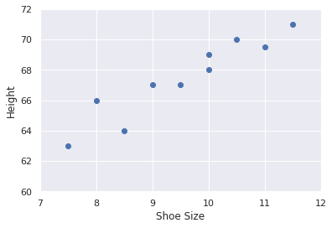
Predicting Height
Data
Input
Function
Output
x
f(x)
y
Shoe Size
Height
Notes:
What does the labeled data look like? Well, it is a set of examples of (input, output) pairs.
By the way, remember our discussion of features. In this case, each input is described by a single feature -- the shoe size. You could imagine we could build a much better predictor of height if we used more features. For now we want to keep things simple, but as we proceed, you might imagine how everything will generalize to more features.

Slide 12
Functional Form
Function
f(x)
Notes:
Now we have a crucial decision to make. We need to choose a form for our function. By specifying “linear regression”, we are agreeing on a specific form.

Slide 13
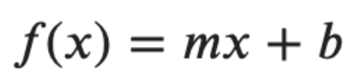
Functional Form
Function
f(x)
Notes:
And that is a line. For whatever reason, the standard equation for a line uses “m” for the slope and “b” for the intercept.

Slide 14
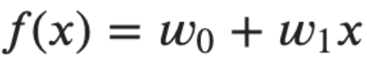
Functional Form
Function
f(x)
Notes:
Let’s change notation slightly and use w0 for the intercept and w1 for the slope.

Slide 15
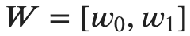
Parameters
Model
Parameters
Notes:
Why? Well, right now, our function -- our model -- has 2 parameters. These are the variables whose values we will attempt to learn from the data. Sometimes it will be convenient to refer to them together as W.
Later on, we will work with models that have hundreds, thousands, even millions of parameters. As I’m preparing these slides, there’s been some media buzz about a model called GPT-3 with 175 billion parameters. So that’s something to look forward to.
The point here is that we are choosing a functional form for how an output is calculated from an input -- in this case, a line -- which in turn gives us a set of variables to estimate, in this case a slope and an intercept. These variables are the parameters of the model.

Slide 16
Parameter Values
Notes:
Ok so we have a functional form which implies a set of parameters. Fully specifying a model means choosing a mapping of values to the parameters.

Slide 17
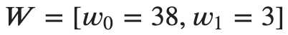
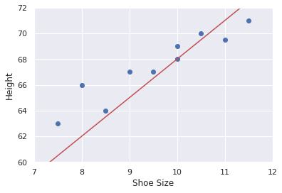
Parameter Values
Notes:
For example, we could set w0 (the intercept) to 38 and w1 (the slope) to 3, resulting in the line drawn here. This model predicts height (in inches) by starting with 38, then adding 3 times their shoe size.

Slide 18
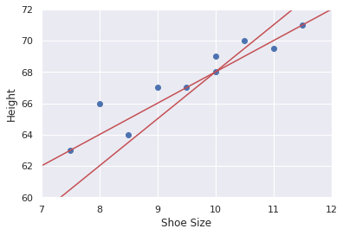

Parameter Values
Notes:
Or we could choose a different assignment of values, say intercept of 42 and slope of 2.

Slide 19
Which is Better?
Notes:
Now for the key question. Which of these parameter settings is better? We can use the mean squared error to answer this question.
[go back and draw]

Slide 20
Which is Better?
MSE = 3.25
MSE = 0.825
Notes:
According to mean squared error, the second setting is better.

Slide 21
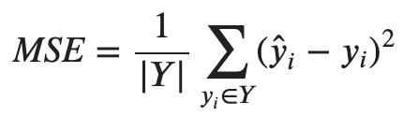
Loss
Notes:
This brings us to another crucial concept: The Loss.
Much like we chose a functional form for our model, we need to choose a way to measure success. For regression problems, the mean squared error is the standard. But there are all kinds of other loss functions we could choose. We could, for example, use absolute error instead of squared error.
As soon as we’ve chosen a loss function, we have an optimization problem. We want to select the parameter values that result in the smallest possible loss.

Slide 22
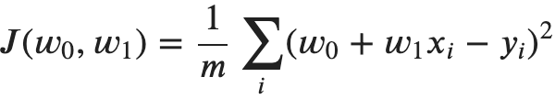
Loss
Notes:
Here’s some mathematical notation. Let’s use J to refer to the loss function. The input to J is a set of parameter values, and the output is the loss with respect to the labeled training examples.
Notice that the functional form of the model is baked into the loss function. In this case it’s mean squared error applied to a linear predictor.

Slide 23
Loss
Minimize!
Notes:
Now we can be very concrete about the goal or objective of the learning process. We want to choose the parameter values that minimize the loss.

Slide 24
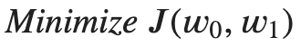
Linear Regression Summary
Model
Parameters
Loss
Objective
Notes:
Let’s review where things stand.
The model is the functional form for our prediction function. It describes how inputs x are used compute outputs y. For linear regression, this is a line with a slope and intercept.
The model is parameterized. That is, to fully specify the model we need to provide values for the parameters in the model. For linear regression, these are slope and intercept values.
The loss function is a different function that compares predictions from the model with the labels and gives a single overall value (confusingly also called the loss) that summarizes how well the parameters fit the data.
Finally, the objective in learning is to minimize the loss, to find the parameter values that give the smallest loss, the best fit for the data.

Slide 25
Linear Regression
Notes:
Q: [True/False] The input to the loss function is a mapping of parameters to values.
A: True

Slide 26
The Loss Function
Notes:
Before we get into gradient descent, I’d like to walk through a very simple example to make sure the relationship between the model and the loss is clear.
The model is a function of the inputs, while the loss is a function of the parameters in the model.
This can get confusing so I hope the example helps make things concrete.

Slide 27
The One-Variable Case
Model
Parameters
Loss
Objective
Notes:
Let’s work with our height from shoe-size prediction setting, but simplify even further.
Let’s replace the bias term, w0, with a fixed value, say 50 (inches, that is).
This gives us a learning problem with a single variable, w1.
[Replace w0 with 50]

Slide 28
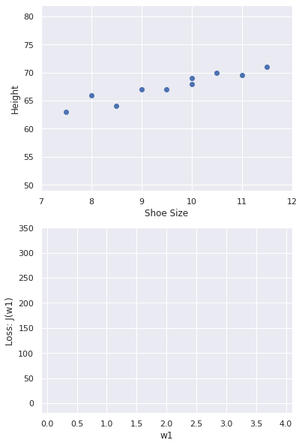
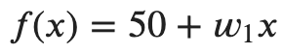
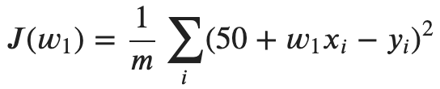
The Loss Curve
Model
Loss
Notes:
To build some intuition about how the loss function relates to the model, I’m going to enumerate a bunch of values for w1.
Each value specifies a model, which I’ll show as a line in the top plot.
Given our training examples, we can compute the corresponding loss, which I’ll plot in the lower plot.
I’ll simply start with w1=0 and gradually increase the value so we can see the shape of the loss function.

Slide 29
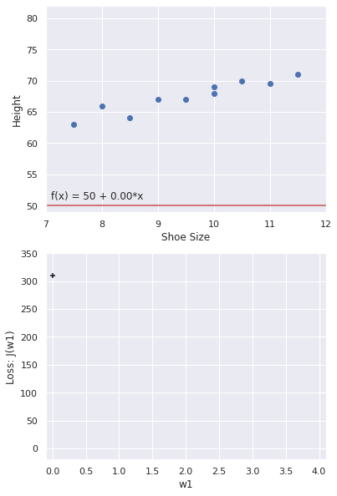
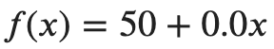
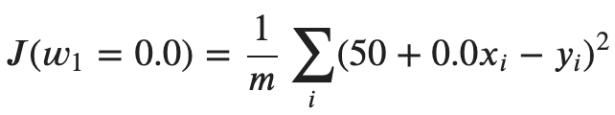
The Loss Curve
Model
Loss
Notes:
Ok, so first we set w1=0. That means our model is 50+0x. A line with 0 slope, shown in red here. It doesn’t look like a particularly good model.
To compute the loss, plug in the model’s prediction into our mean squared error formula.
It comes out around 300. So on average, the predictions are off by sqrt(300) or about 17.

Slide 30
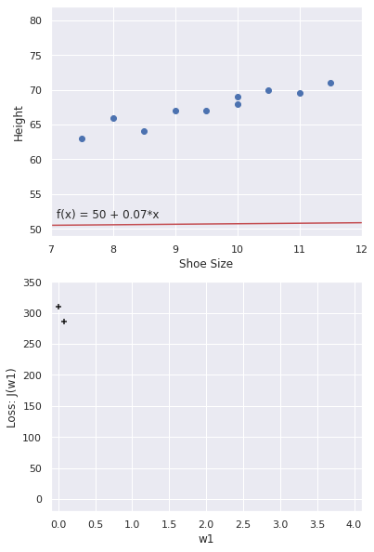
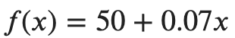
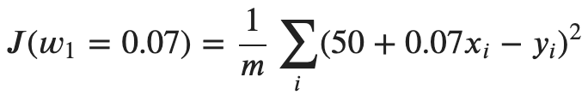
The Loss Curve
Model
Loss

Slide 31
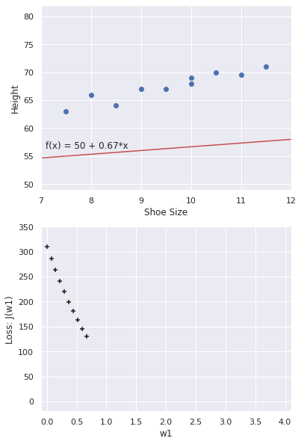
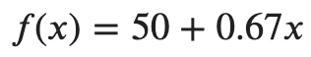
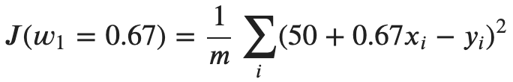
The Loss Curve
Model
Loss

Slide 32
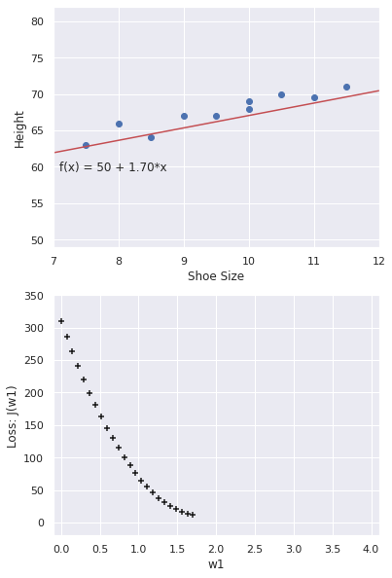
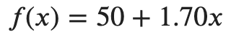
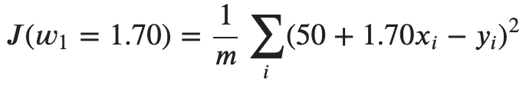
The Loss Curve
Model
Loss

Slide 33
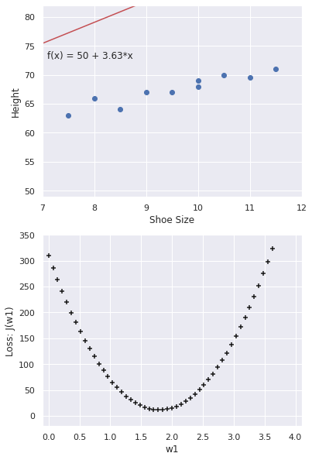
The Loss Curve
Why does the loss function have this shape?
Notes:
Why a parabola?
Why this particular parabola?

Slide 34
The Loss Curve
Why does the loss function have this shape?
Why does the loss not reach zero?

Slide 35
The Loss Curve
Why does the loss function have this shape?
Why does the loss not reach zero?
Did we just show an efficient way to solve the loss minimization problem?

Slide 36
The Loss Function
Notes:
Q: [True/False] The loss function for any training data is minimized when its value is 0.
A: False

Slide 37
Gradient Descent: Intuition

Slide 38
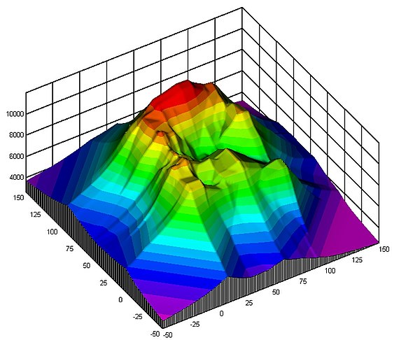
Topography
Imagine trying to get to the highest peak... in the dark
[image source]
Notes:
Let’s start with an analogy. Forget about models and losses for a moment and imagine trying to climb to the highest peak in a complex landscape. In addition, imagine that it’s completely dark. What would you do?
You wouldn’t be able to zoom out and get the drone view like in this contour diagram. But you should be able to tell with each step if you are going up or down.
So if you want to get to the top, you’d probably generally try to go up.
This is the idea of gradient descent -- well technically this would be gradient ascent since I said we were climbing to the peak rather than descending to the lowest point…
Mathematically, the gradient is a vector that points in the steepest direction along each axis. If your strategy for getting to the top is take the steepest possible next step, then you are performing gradient ascent.

Slide 39
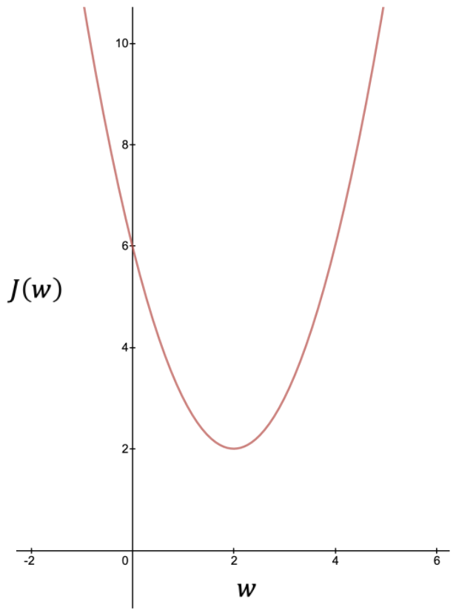
One-Variable Loss
Objective: find w that minimizes J
This setting yields the best fit for the training data (according to MSE)
Notes:
Let’s get back to a now familiar shape curve -- the loss relative to a single parameter w.

Slide 40
One-Variable Loss
Doesn’t this curve make it clear where J is minimized?
Notes:
Well, yes, but as we’ve discussed, creating this curve involves evaluating the loss exhaustively on all values of the parameters.

Slide 41
Gradient Descent Intuition
Choose some initial value for w

Slide 42
Gradient Descent Intuition
Should we increase or decrease w?
How do we decide mathematically?

Slide 43
Gradient Descent Intuition
The slope (gradient) is useful.

Slide 44
Gradient Descent Intuition
Positive gradient:
w should be smaller

Slide 45
Gradient Descent Intuition
Negative gradient:
w should be larger

Slide 46
Gradient Descent Intuition
And the steeper the slope, the larger the step we might take

Slide 47
Gradient Descent Intuition
Keep updating w by following the gradient, until it stops changing (much).

Slide 48
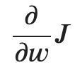
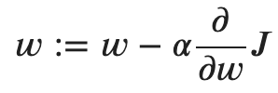
Parameter Update Rule
The gradient is given by:
And the corresponding update for w is:

Slide 49
Learning Rate
Need to choose the learning rate carefully
If too large, J diverges

Slide 50
Learning rate
Need to choose the learning rate carefully
If too small, J converges too slowly

Slide 51
Learning rate
The learning rate is a hyper-parameter

Slide 52
Gradient Descent: Intuition
Notes:
Q: [True/False] Gradient descent will always converge.
False

Slide 53
Gradient Descent: Derivation
Notes:
It’s time for some calculus.
Most of the math in machine learning involves vectors and matrices -- linear algebra.
But gradient descent, the central algorithm, relies on taking some derivatives.
These days, the software tools do all the math for you, including the derivatives. But it’s worth getting to the bottom, mathematically speaking, of at least this simple example.

Slide 54
Linear Regression Summary
Model
Parameters
Loss
Objective
Notes:
Ok, so by now you should feel pretty comfortable with all these pieces of linear regression.
You know that the model is a function that maps inputs to outputs, and it is fully specified once we’ve assigned values to its parameters.
You know that in linear regression with a single input (x), we have 2 parameters, w0 and w1, the intercept and slope.
You know that the loss is a function that quantifies how well the model fits the labeled data, the examples of (x, y). In this case it is an application of MSE to our model.
And finally you know that our goal or objective is minimize the loss. This is the point where our parameter assignments are optimal according to the loss applied to the training data.
We just talked about how gradient descent efficiently minimizes the loss by following the gradient. So the only missing piece is how to compute the gradient.

Slide 55
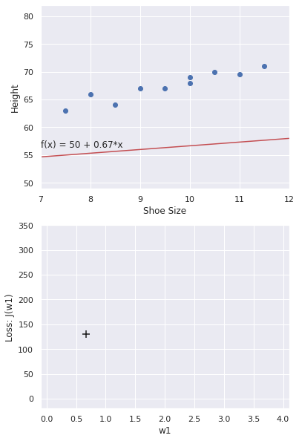
Where to Next?
Model
Loss
Notes:
For example, suppose you happen to start here.
Remember in general you don’t have the luxury at just looking at the shape of the loss curve to see where you are.
You need to figure out the slope -- descending in the dark.
This is possible only because we have previously agreed on the form for the model -- linear regression.
We are now going to show how to compute the gradient for linear regression.

Slide 56
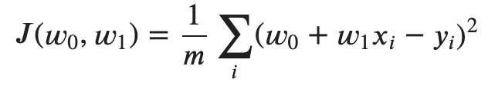
Gradient for w1
Notes:
While previously we simplified things to just a single parameter, let’s jump back to the two-parameter case to make sure it’s clear how to compute gradients in general.

Slide 57
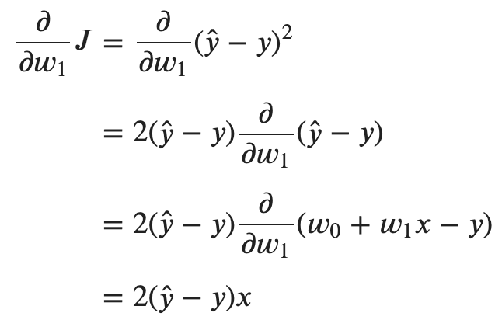
Gradient for w1

Slide 58
Gradient for w1

Slide 59
Gradient for w1

Slide 60
Gradient for w1
Notes:
Note that if the difference between prediction and label

Slide 61
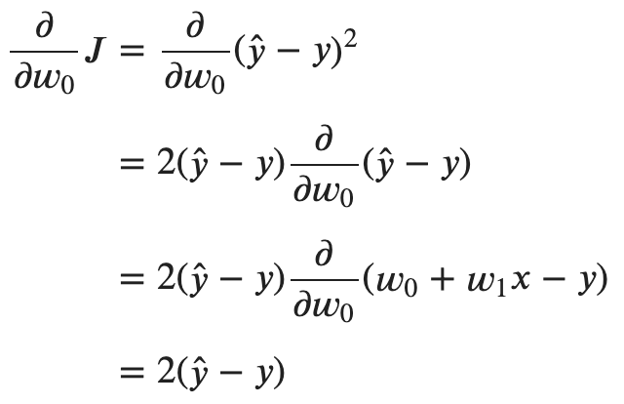
Gradient for w0
Notes:
Note that if the prediction is larger than the label, the gradient is positive, so we’d decrease w0.
And if the prediction is smaller than the label, the gradient is negative, so we’d increase w0.
If the prediction is exactly the same as the label, well, the gradient is zero.

Slide 62
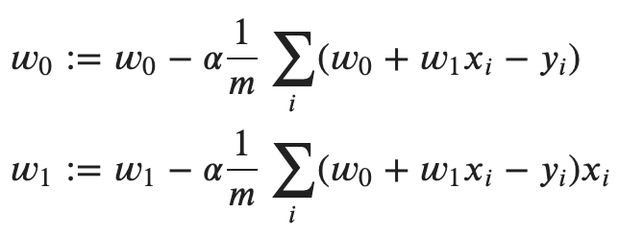
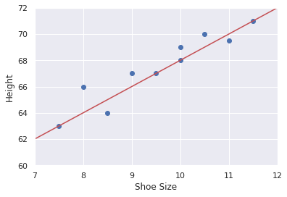
Gradient descent algorithm

Slide 63
Gradient Descent: Derivation
Notes:
Q: [True/False] The gradient is computed separately for each parameter.
A: True

Slide 64
Gradient Descent: In Practice
Notes:
I’d like to go over some important details regarding how gradient descent is actually used, and what kinds of issues come up.

Slide 65
Stochastic Gradient Descent
x0 y0
x1 y1
x2 y2
x3 y3
x4 y4
x5 y5
x6 y6
x7 y7
x8 y8
x9 y9
x10 y10
x11 y11
x12 y12
x13 y13
x14 y14
x15 y15
x16 y16
x17 y17
x18 y18
x19 y19
x20 y20
… …

Slide 66
Stochastic Gradient Descent
x0 y0
x1 y1
x2 y2
x3 y3
x4 y4
x5 y5
x6 y6
x7 y7
x8 y8
x9 y9
x10 y10
x11 y11
x12 y12
x13 y13
x14 y14
x15 y15
x16 y16
x17 y17
x18 y18
x19 y19
x20 y20
… …
Gradient Descent: estimate gradient from all data

Slide 67
Stochastic Gradient Descent
x0 y0
x1 y1
x2 y2
x3 y3
x4 y4
x5 y5
x6 y6
x7 y7
x8 y8
x9 y9
x10 y10
x11 y11
x12 y12
x13 y13
x14 y14
x15 y15
x16 y16
x17 y17
x18 y18
x19 y19
x20 y20
… …
Gradient Descent: estimate gradient from all data
Inefficient for large datasets
Unnecessarily precise estimate of gradient

Slide 68
Stochastic Gradient Descent
x0 y0
x1 y1
x2 y2
x3 y3
x4 y4
x5 y5
x6 y6
x7 y7
x8 y8
x9 y9
x10 y10
x11 y11
x12 y12
x13 y13
x14 y14
x15 y15
x16 y16
x17 y17
x18 y18
x19 y19
x20 y20
… …
GD: estimate gradient from all data
SGD: estimate gradient from 1 example
1

Slide 69
Stochastic Gradient Descent
x0 y0
x1 y1
x2 y2
x3 y3
x4 y4
x5 y5
x6 y6
x7 y7
x8 y8
x9 y9
x10 y10
x11 y11
x12 y12
x13 y13
x14 y14
x15 y15
x16 y16
x17 y17
x18 y18
x19 y19
x20 y20
… …
GD: estimate gradient from all data
SGD: estimate gradient from 1 example
2

Slide 70
Stochastic Gradient Descent
x0 y0
x1 y1
x2 y2
x3 y3
x4 y4
x5 y5
x6 y6
x7 y7
x8 y8
x9 y9
x10 y10
x11 y11
x12 y12
x13 y13
x14 y14
x15 y15
x16 y16
x17 y17
x18 y18
x19 y19
x20 y20
… …
GD: estimate gradient from all data
SGD: estimate gradient from 1 example
3

Slide 71
Stochastic Gradient Descent
x0 y0
x1 y1
x2 y2
x3 y3
x4 y4
x5 y5
x6 y6
x7 y7
x8 y8
x9 y9
x10 y10
x11 y11
x12 y12
x13 y13
x14 y14
x15 y15
x16 y16
x17 y17
x18 y18
x19 y19
x20 y20
… …
GD: estimate gradient from all data
SGD: estimate gradient from 1 example
Gradient estimates are very noisy
3

Slide 72
Stochastic Gradient Descent
x0 y0
x1 y1
x2 y2
x3 y3
x4 y4
x5 y5
x6 y6
x7 y7
x8 y8
x9 y9
x10 y10
x11 y11
x12 y12
x13 y13
x14 y14
x15 y15
x16 y16
x17 y17
x18 y18
x19 y19
x20 y20
… …
GD: estimate gradient from all data
SGD: estimate gradient from 1 example
Mini-batch SGD: estimate gradient from small batches of examples
1

Slide 73
Stochastic Gradient Descent
x0 y0
x1 y1
x2 y2
x3 y3
x4 y4
x5 y5
x6 y6
x7 y7
x8 y8
x9 y9
x10 y10
x11 y11
x12 y12
x13 y13
x14 y14
x15 y15
x16 y16
x17 y17
x18 y18
x19 y19
x20 y20
… …
GD: estimate gradient from all data
SGD: estimate gradient from 1 example
Mini-batch SGD: estimate gradient from small batches of examples
2

Slide 74
Stochastic Gradient Descent
x0 y0
x1 y1
x2 y2
x3 y3
x4 y4
x5 y5
x6 y6
x7 y7
x8 y8
x9 y9
x10 y10
x11 y11
x12 y12
x13 y13
x14 y14
x15 y15
x16 y16
x17 y17
x18 y18
x19 y19
x20 y20
… …
GD: estimate gradient from all data
SGD: estimate gradient from 1 example
Mini-batch SGD: estimate gradient from small batches of examples
3

Slide 75
Stochastic Gradient Descent
x0 y0
x1 y1
x2 y2
x3 y3
x4 y4
x5 y5
x6 y6
x7 y7
x8 y8
x9 y9
x10 y10
x11 y11
x12 y12
x13 y13
x14 y14
x15 y15
x16 y16
x17 y17
x18 y18
x19 y19
x20 y20
… …
GD: estimate gradient from all data
SGD: estimate gradient from 1 example
Mini-batch SGD: estimate gradient from small batches of examples
Used in practice
Batch size is a hyper-parameter
Referred to as SGD
3

Slide 76
Stochastic Gradient Descent
x0 y0
x1 y1
x2 y2
x3 y3
x4 y4
x5 y5
x6 y6
x7 y7
x8 y8
x9 y9
x10 y10
x11 y11
x12 y12
x13 y13
x14 y14
x15 y15
x16 y16
x17 y17
x18 y18
x19 y19
x20 y20
… …
GD: estimate gradient from all data
SGD: estimate gradient from 1 example
Mini-batch SGD: estimate gradient from small batches of examples
A single pass through the data is an epoch

Slide 77
Stochastic Gradient Descent
x0 y0
x1 y1
x2 y2
x3 y3
x4 y4
x5 y5
x6 y6
x7 y7
x8 y8
x9 y9
x10 y10
x11 y11
x12 y12
x13 y13
x14 y14
x15 y15
x16 y16
x17 y17
x18 y18
x19 y19
x20 y20
… …
GD: estimate gradient from all data
SGD: estimate gradient from 1 example
Mini-batch SGD: estimate gradient from small batches of examples
A single pass through the data is an epoch
How many epochs do you need?

Slide 78
Differentiable Loss Functions
Not all loss functions are differentiable.
Tools like TensorFlow or PyTorch have built-in tricks.
Notes:
Let’s talk for a moment about the convenient shape of this loss curve. I described how to take derivatives with respect to this function, which happens to work regardless the current value of w.
But not all functions are differentiable, and in general we might have reason to prefer a different loss.
Take, for example, the absolute error -- removing the squared part and using an absolute value. A negative loss, by the way, doesn’t make sense.

Slide 79
Local Minima
Will gradient descent reach the global minimum?
J
w
Notes:
Speaking of convenient shapes, the parabola shape is convenient for another reason. Consider this funny looking loss curve.

Slide 80
Local Minima
Will gradient descent reach the global minimum?
How could we improve our chances?
J
Local minimum
w

Slide 81
Local Minima
Will gradient descent reach the global minimum?
How could we improve our chances?
Most loss functions are non-convex
J
Local minimum
w

Slide 82
Local Minima
Will gradient descent reach the global minimum?
How could we improve our chances?
Most loss functions are non-convex
Linear regression is convex
J
Local minimum
w

Slide 83
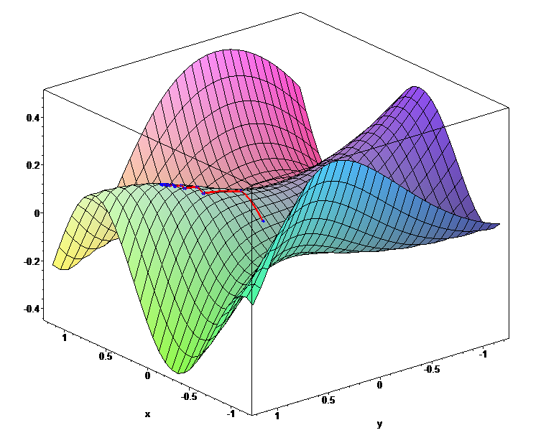
Tricky Loss Functions
What about saddle points or plateaus?
[image source]

Slide 84
Notes on the Gradient
Compute a partial derivative for each parameter (holding others constant)

Slide 85
Notes on the Gradient
Compute a partial derivative for each parameter (holding others constant)
Stack the partial derivatives in a vector

Slide 86
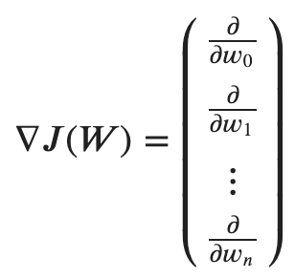
Notes on the Gradient
Compute a partial derivative for each parameter (holding others constant)
Stack the partial derivatives in a vector
That’s the gradient

Slide 87
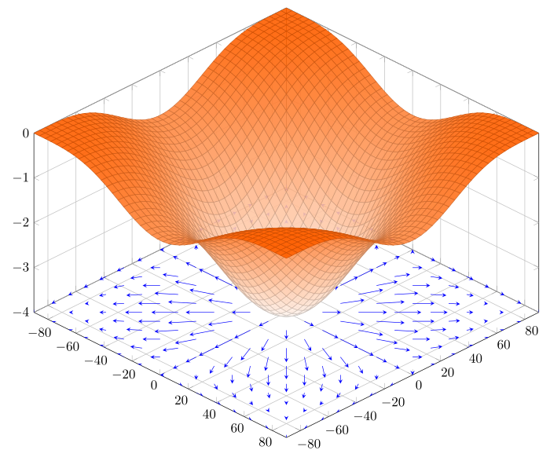
Notes on the Gradient
Compute a partial derivative for each parameter (holding others constant)
Stack the partial derivatives in a vector
That’s the gradient
It points in the direction of steepest ascent
[image source]

Slide 88
Review
Define: model, loss, parameters, objective.
What does learning by optimization mean?
Why do we need gradient descent?
What does a batch refer to in SGD?
Do we stop SGD when the loss reaches 0?

Slide 89
Gradient Descent: In Practice

